Slide 1
Deliverable 3
Adam Afilaka: Developer/Programmer
Ashley Braun: Business Analyst/Project Manager
Zaid Islam: Cyber Security Engineer
Rithika Sayini: Researcher/Programmer
Shanese Scott: Database Administrator
Xin Zheng: Quality Assurance

Slide 2
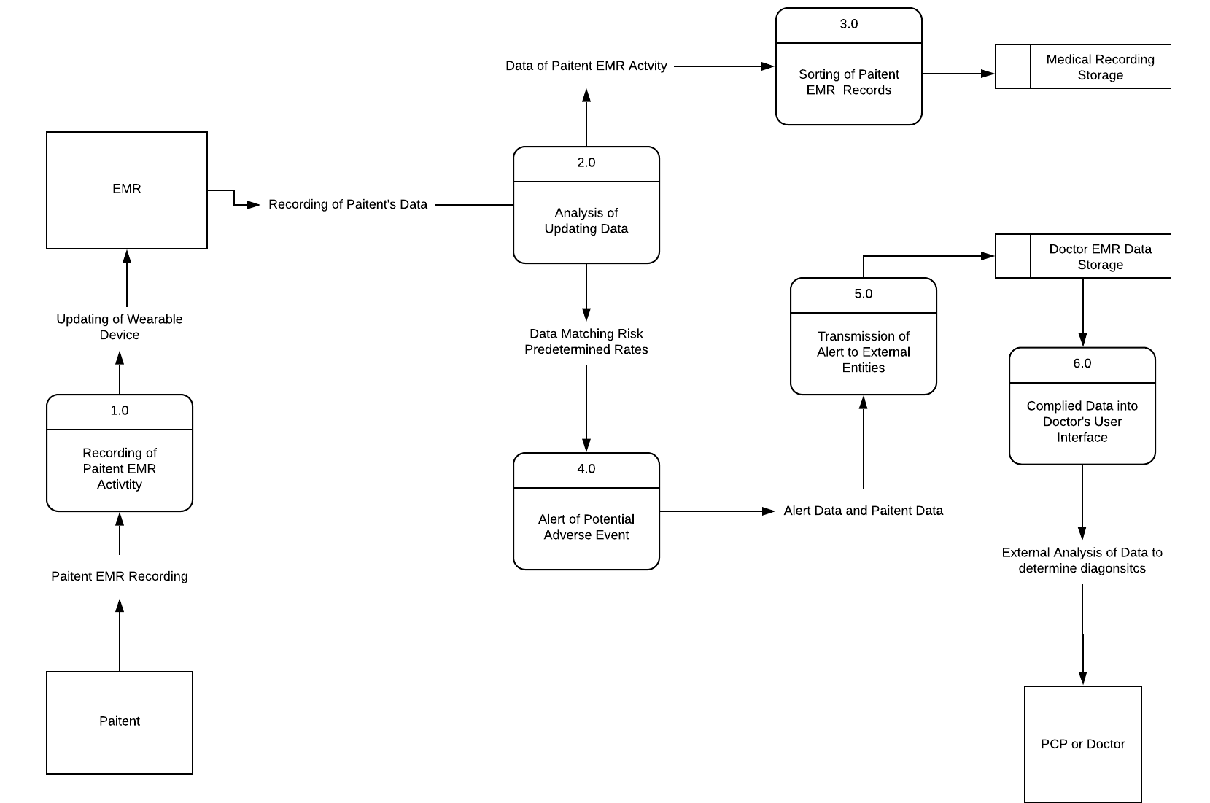
Level 0

Slide 3
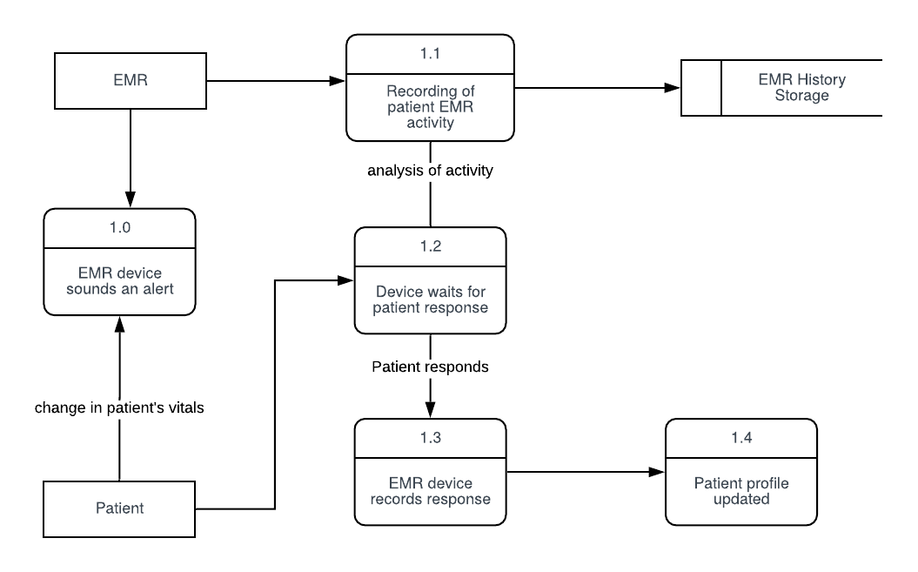
Process 1 - Recording of Patient EMR Activity

Slide 4
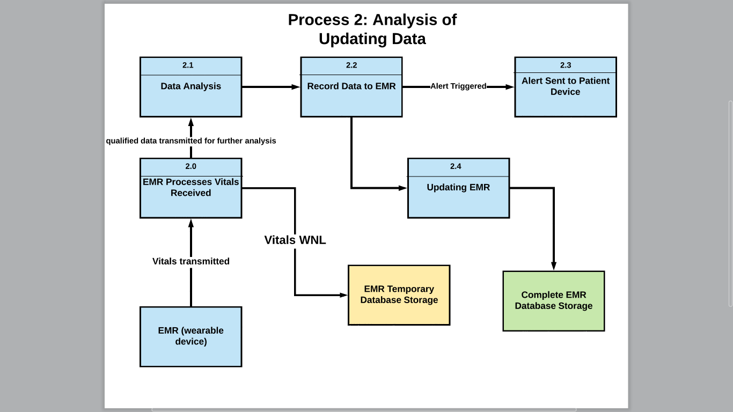
Level 2

Slide 5
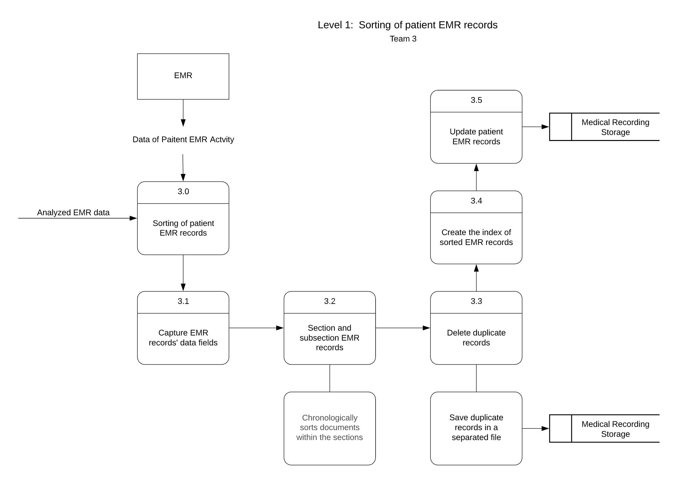
Process 3 - Sorting of Patient EMR Records
External Entities: EMR
Processes:
Capture EMR records' data fields
Section and subsection EMR records
Delete duplicate records
Create the index of sorted EMR records
Update patient EMR records
Data Storages:
Medical Recording Storage

Slide 6
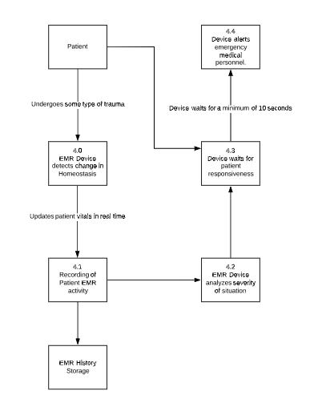
Process 4
Alert of Potential Adverse Event
External Entities:
EMR Wearable Device
Processes:
4.0- EMR Device Detects Change in Homeostasis
4.1 - Recording of Patient EMR Activity
4.2 - EMR Device Analyzes Severity of Situation
4.3 - Device Waits for Patient Responsiveness
4.4 - Device Alerts Emergency Medical Personnel
Data Storages:
EMR History Storage

Slide 7
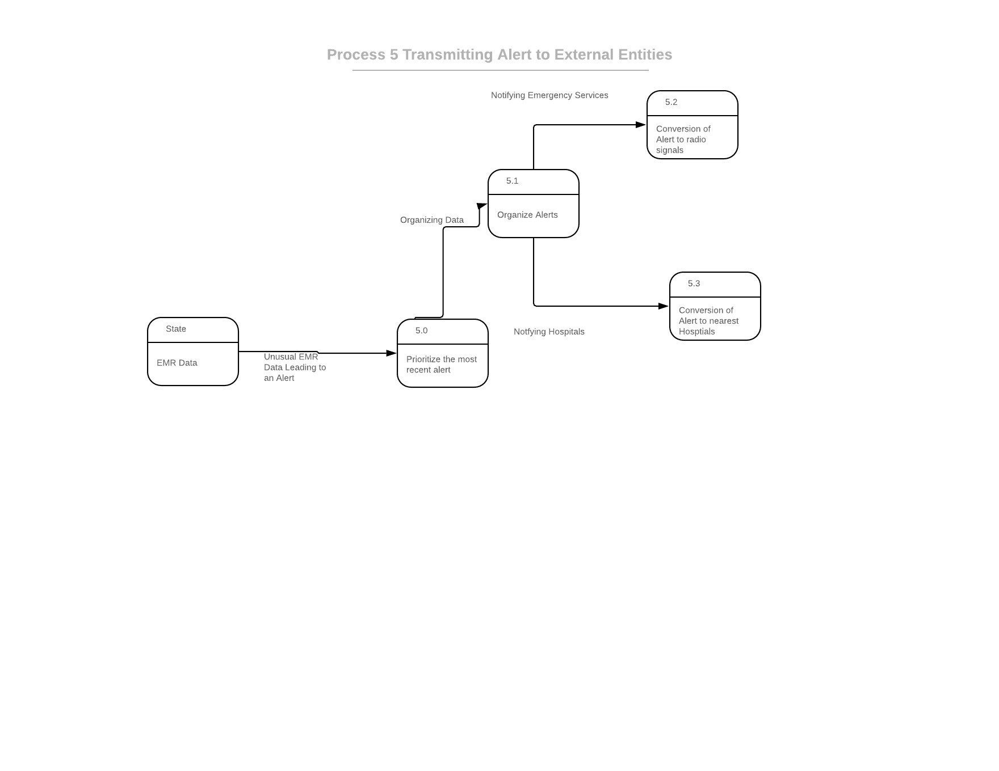
Process 5 - Transmission of Alert to External Entities
Prioritize the most recent alert
Organize alerts
Conversion of Alert to Radio Signals
Conversion of Alert to Nearest Hospitals

Slide 8
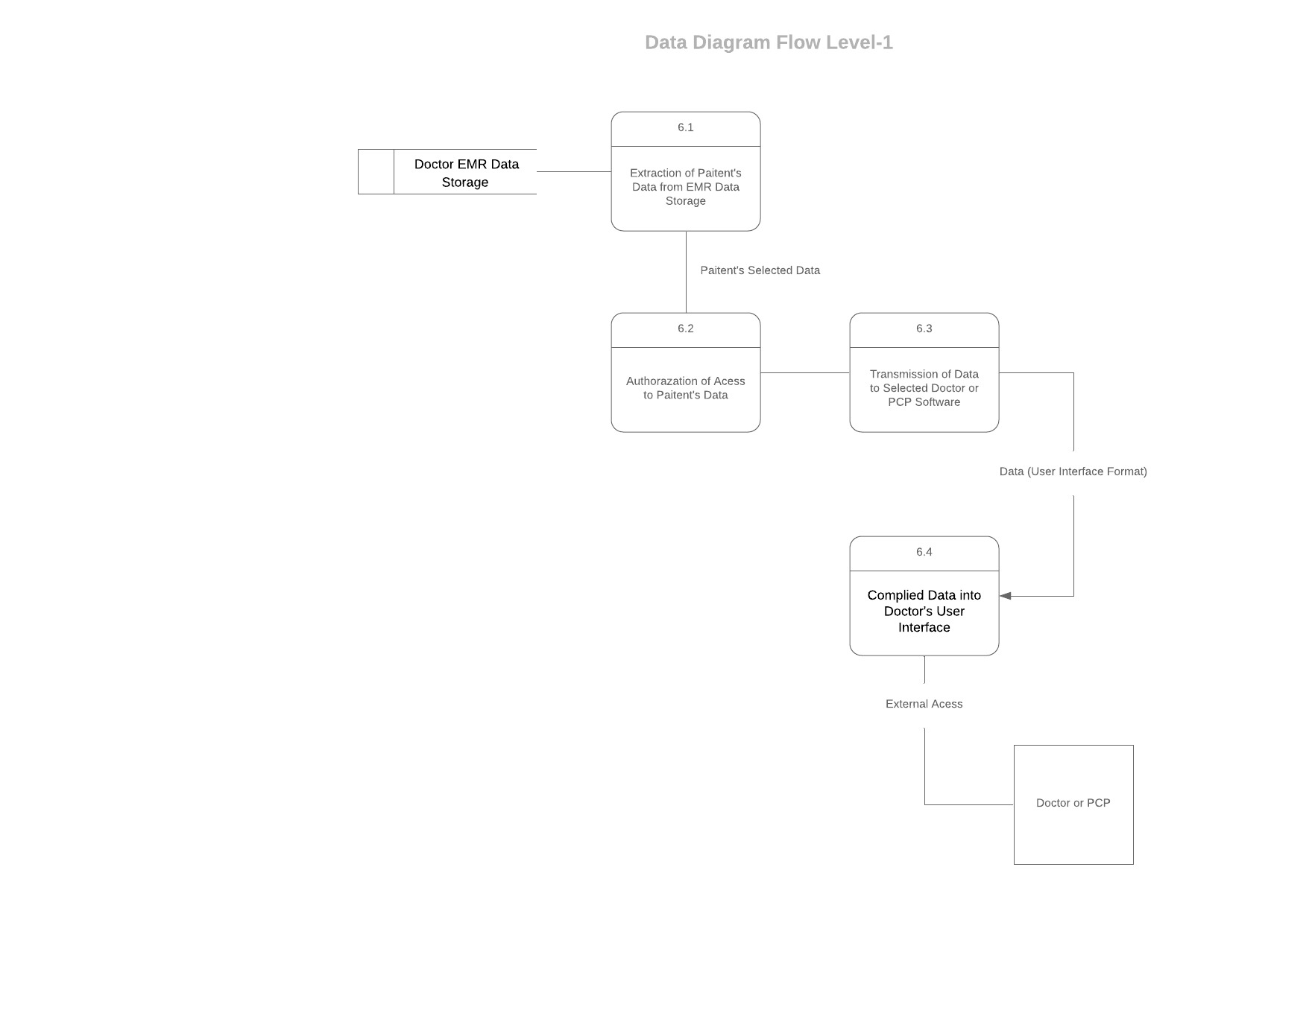
Process 6 - Compiled Data into Doctor’s User Interface

Slide 9
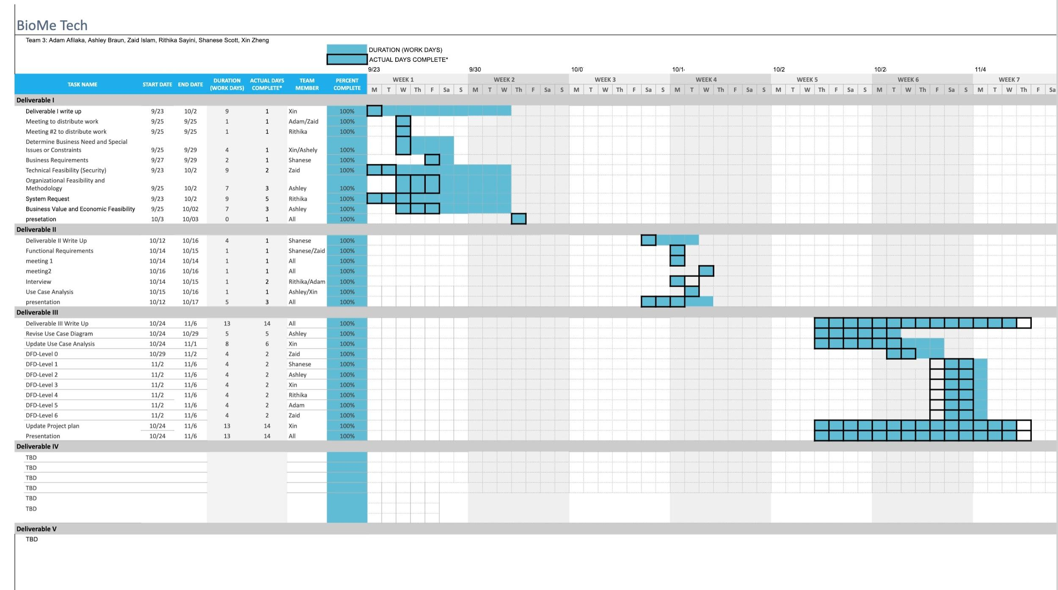
Project Plan

